Slide 1
11617 Arranging a Sequence

Slide 2
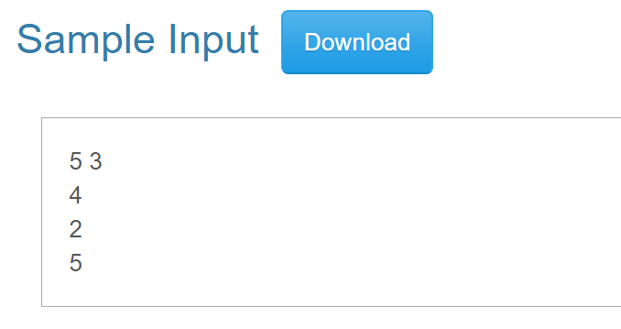
Question：
Given two integers n, m
n is the length of the sequence
m is the number of requests
Each of the following m lines contains an integer e, meaning that
moving e in the sequence to the head of the sequence

Slide 3
Method one: Direct simulation

Slide 4
First. Build the initial sequence
0 | 0 | 0 | 0 | 0
0 | 1 | 2 | 3 | 4

Slide 5
Second. Find e in the sequence
#include<stdio.h>
int main(){
。。。。
while(m--){
scanf(“%d”,&input);
int pos;
for(i=1; i<=n; i++){
if(seq[i]==input){
pos = i;
break;
}
}
。。。。
}
}
Ex: e = 2
0 | 1 | 2 | 3 | 4

Slide 6
Third. Shift the sequence
0
1
2
 |  |  | 3 | 4

Slide 7
3-1: Put e into seq[0]
#include<stdio.h>
int main(){
。。。。
while(m--){
scanf(“%d”,&input);
int pos;
for(i=1; i<=n; i+){
if(seq[i]==input){
pos = i;
}
}
seq[0] = seq[pos];
。。。。
}
for(i=1; i<=n;i++){
printf(“%d\n”,seq[i]);
}
}
2
0
1
2
 |  |  | 3 | 4

Slide 8
3-2: Shift the sequence
#include<stdio.h>
int main(){
。。。。
while(m--){
scanf(“%d”,&input);
int pos;
for(i=1; i<=n; i+){
if(seq[i]==input){
pos = i;
}
}
seq[0] = seq[pos];
for(i=pos-1; i>=0; i--){
seq[i+1] = seq[i];
}
}
for(i=1; i<=n;i++){
printf(“%d\n”,seq[i]);
}
}
pos
2
2
1
2
1
 |  |  | 3 | 4
i-- >= 0;
i = pos -1;

Slide 9
Problem
Find the position of input -> one loop
Shift the sequence -> another loop
When the test case is very large, it may cause TLE

Slide 10
Method2

Slide 11
Think about the problem, observe the sample output
From the problem description, we can know that the later input will be at the front of the output

Slide 12
Example:
Input:
Output:
5
3
2
4
5
0
1
2
3
4
5

Slide 13
Example 2:
Input:
Output:
5
3
5
1
5 has been processed, ignore it
5
0
1
2
3
4
5

Slide 14
Think about what we need?
1. An array that records the input -> m_inst[]
2. An array that shows the state of each number -> f_mv[]
0: the number is not moved
1: the number is moved
-1: the number has been processed

Slide 15
First: Process all the input
#include <stdio.h>
int f_mv[200001] = {0};
int m_inst[100000] = {0};
int main(){
。。。。。。
tmp = m;
while(tmp--){
scanf("%d",&e);
m_inst[tmp] = e;
f_mv[e] = 1;
}
。。。。。。
return 0;
}
5
3
5
5
1
1
5
5
m_inst[]
Value:
f_mv[]
tmp
Index: | 0 | 1 | 2 | 3 | 4 | 5
Value: | 0 |  | 0 | 0 | 0
1
0
0
1
Notes:
加 m_inst[] 的index箭頭
Value 跟 index 交換

Slide 16
#include <stdio.h>
int f_mv[200001] = {0};
int m_inst[100000] = {0};
int main(){
tmp = m;
while(tmp--){
scanf("%d",&e);
m_inst[tmp] = e;
f_mv[e] = 1;
}
for(i=0;i<m;i++){
if(f_mv[m_inst[i]] == 1){
printf("%d\n",m_inst[i]);
f_mv[m_inst[i]] = -1;
}else{}
}
。。。。。。
return 0;
}
Second: print reversely
the numbers that have been moved
Output:
m_inst[]
1
5
1
5
Value:
5
f_mv[]
-1:has been moved
ignore the number
1: hasn’t been outputted;
print;
set flag to -1;
Index: | 0 | 1 | 2 | 3 | 4 | 5
 | 0 |  | 0 | 0 | 0
-1
1
Value:
1
-1

Slide 17
#include <stdio.h>
int f_mv[200001] = {0};
int m_inst[100000] = {0};
int main(){
tmp = m;
while(tmp--){
scanf("%d",&e);
m_inst[tmp] = e;
f_mv[e] = 1;
}
for(i=0;i<m;i++){
if(f_mv[m_inst[i]] == 1){
printf("%d\n",m_inst[i]);
f_mv[m_inst[i]] = -1;
}else{}
}
for(i=1; i<=n;i++){
if(f_mv[i] == 0){
printf("%d\n",i);
}else{}
}
return 0;
}
Third: print the numbers that have not been moved
Output:
5
1
-1:has been moved
Ignore the number
0:hasn’t been moved
Print the number
-1:has been moved
Ignore the number
f_mv[]
Index: | 0 | 1 | 2 | 3 | 4 | 5
Value: | 0 | -1 | 0 | 0 | 0 | -1
2
3
4

